Slide 1


BM@N Run 8 raw data reconstruction on distributed infrastructure with DIRAC
Konstantin Gertsenberger , Igor Pelevanyuk
LHEP
MLIT
10th BM@N Collaboration Meeting, 14-19 May 2023,

Slide 2
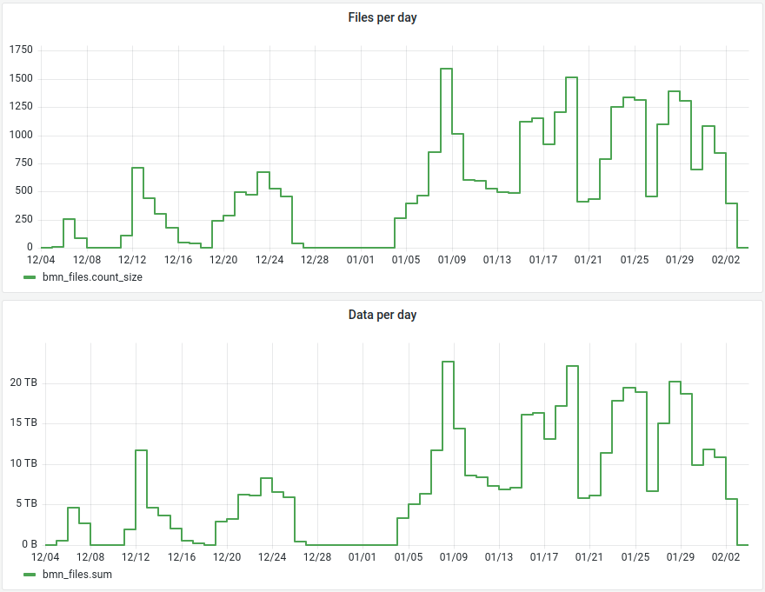
Run8 Data collection
Total files: 31306
Total raw size ~ 436 TB

Slide 3

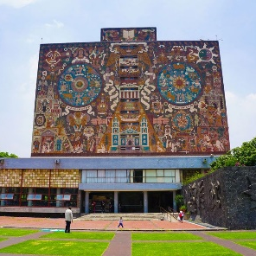




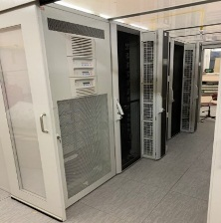
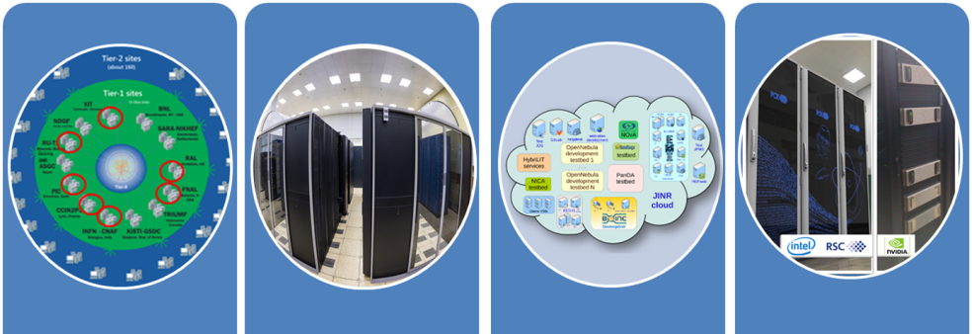
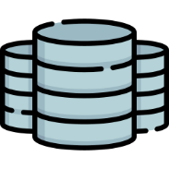
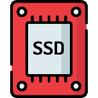
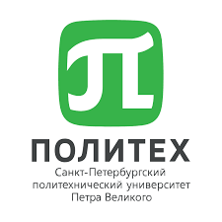

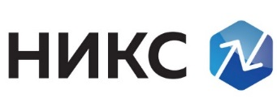
DIRAC in JINR
UNAM
MICC basic facility
NICA cluster
MLIT EOS
Clouds
Tier-1
Tier-2
Govorun
Lustre
Ultra-fast storage
NRCN (National Research Computer Network) is the Russia's largest research and education (R&E) network. May allow execution of jobs submitted to Govorun on a resources of the network. Massive tests with MPD jobs were performed successfully in the beginning of 2022
Polytech
MSC

Slide 4


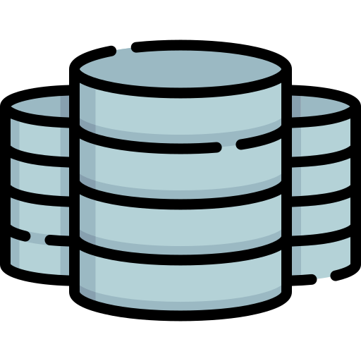
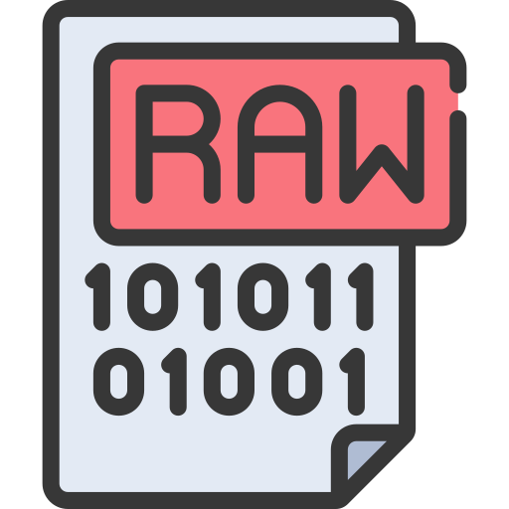
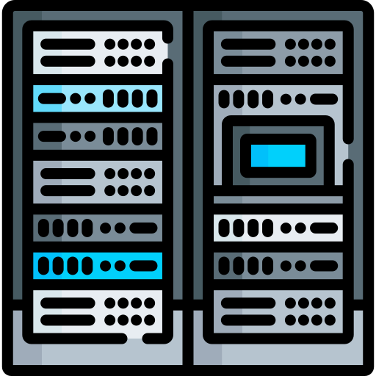
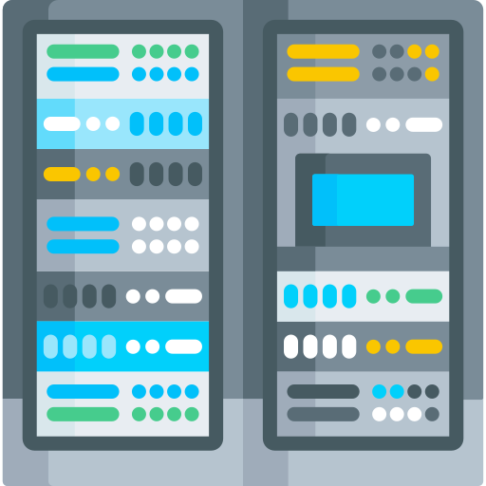
General scheme of resources
Step 1: data transfer
EOS MLIT
EOS LHEP
Tier1
Tier2
Govorun
NICA Cluster

Slide 5
Step 1: Data transfer
EOS MLIT
EOS LHEP
20 DIRAC Jobs
Tier1
Tier2
Govorun
NICA Cluster
Single stream of xrootd transfer can not exceed 100MB/s.
NCX10* can sustain not more than 10 streams(1GB/s total). And that would overload its network.
So, 20 independent DIRAC jobs were sent to NICA cluster to perform transfers with one stream each.

Slide 6
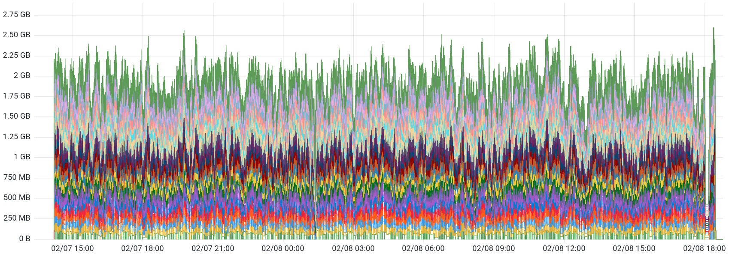
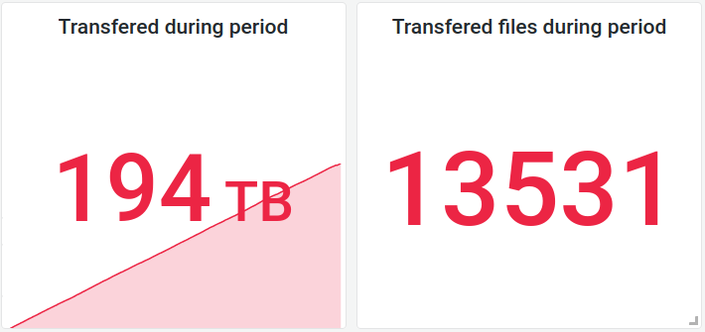
Step 1: Data transfer
Average transfer speed on 20 streams
1.92 GB/s
Total transfer duration:
2d 15h

Slide 7
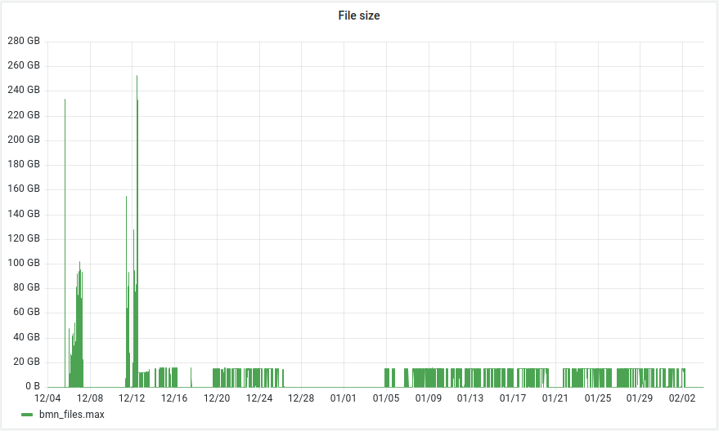
Step 2: Estimate the load
Size of files created during Run 8

Slide 8
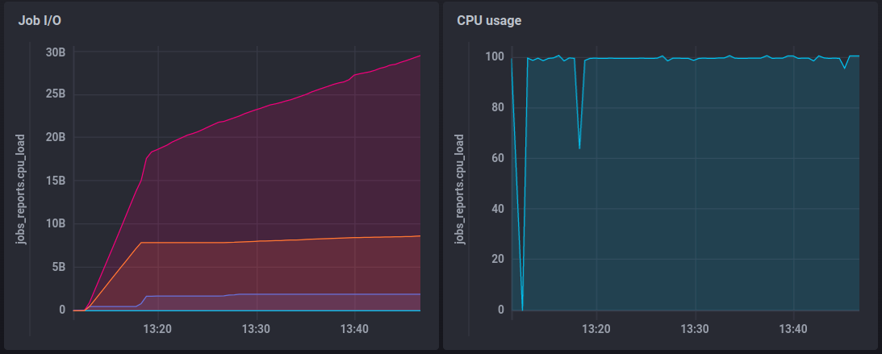
Step 2: Raw2Digi job profiling
Bites read from disk
Read raw file and temporary file
Bites written to disk
Write resulting Digi file
RAM usage
Disk usage
Temporary file: +8 GB
Result file: 800MB
Total disk usage per 15 GB job: 25 GB
Initial read of 15GB raw file and creation of temporary 8 GB file
RAM usage : ~2GB

Slide 9
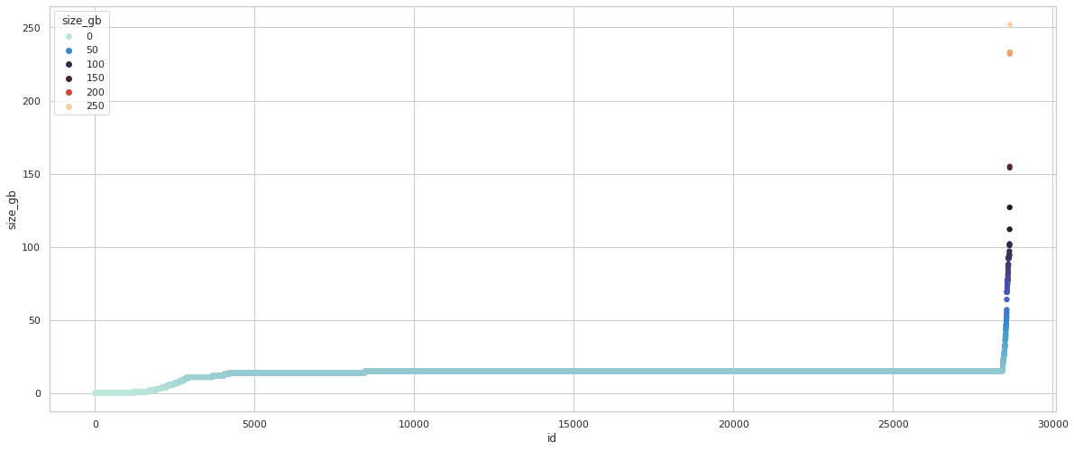
Step 2: Raw file size sorted
Govorun
15%
< 14 GB
84%
14-16 GB
1%
> 16 GB
Tier1, NICA cluster
15
Only Govorun can efficiently process jobs with more than 30 GB of disk usage per one CPU core due to avalability of Luster storage attached to each worknode.
Luckly, in run 8 it is just 1% of all files that are larger than 16 GB. They can be processed on Tier1 and NICA cluster(150 slots)

Slide 10
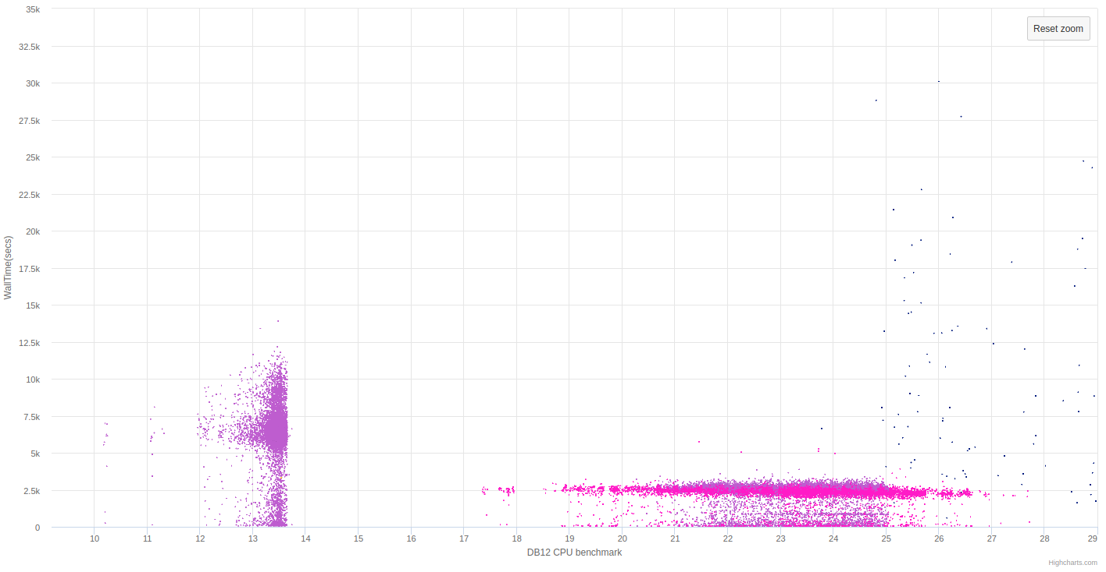
Step 3: Massive production Raw2Digi
Total duration of Raw2Digi campaign – 35 hours
Duration of a job
Each point is a job with particular duration on a core with particular perfomance the benchmark
Tier1 old cores
Govorun
Tier1 new cores
and NICA cluster
CPU core performance on benchmarks

Slide 11
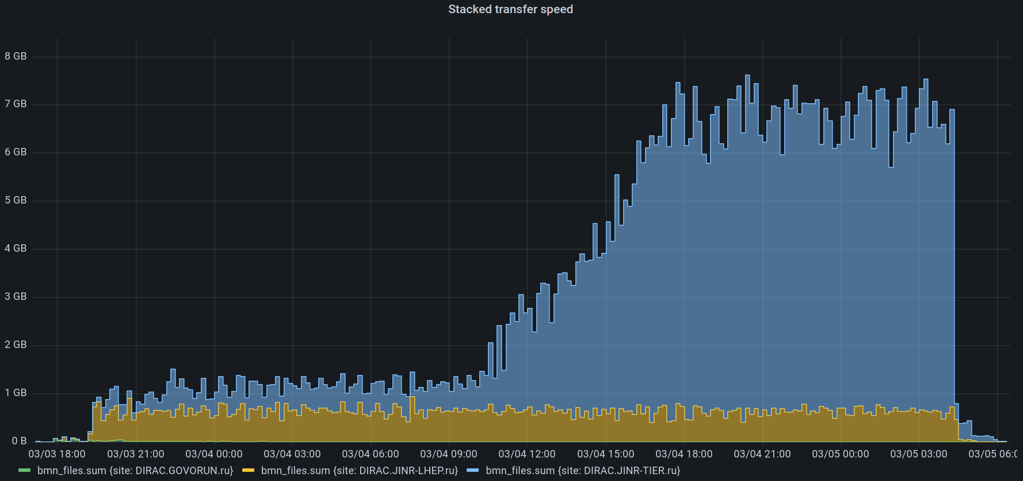
Step 3: Network usage
300 jobs running
4 MB/s per job
NICA Cluster
Tier1
1580 jobs running
4.1 MB/s per job
Maximal transfer speed (Read+Write) with EOS in MLIT – 7.5 GB/s

Slide 12
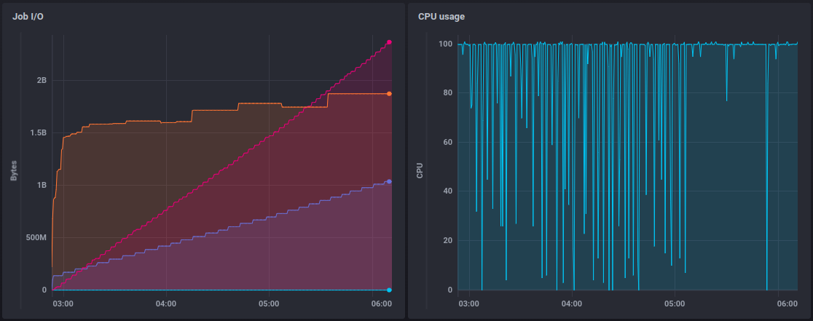
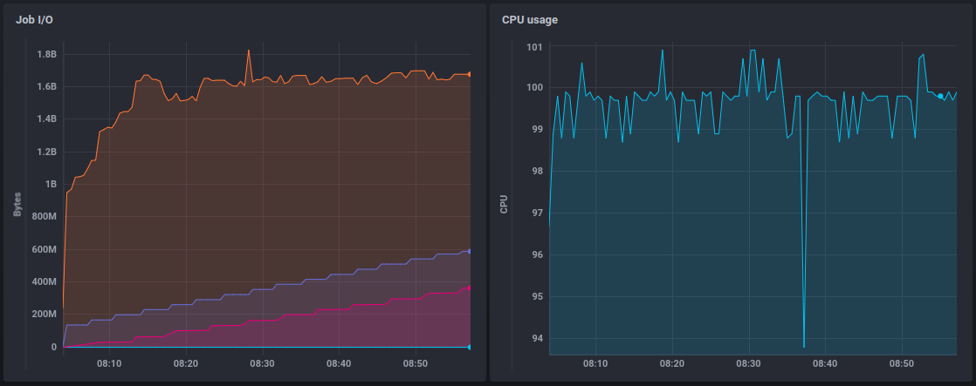
Step 4: Digi2Dst profiling
Bites written to disk
RAM usage
Bites read from disk
Bites written to disk
RAM usage
Bites read from disk

Slide 13
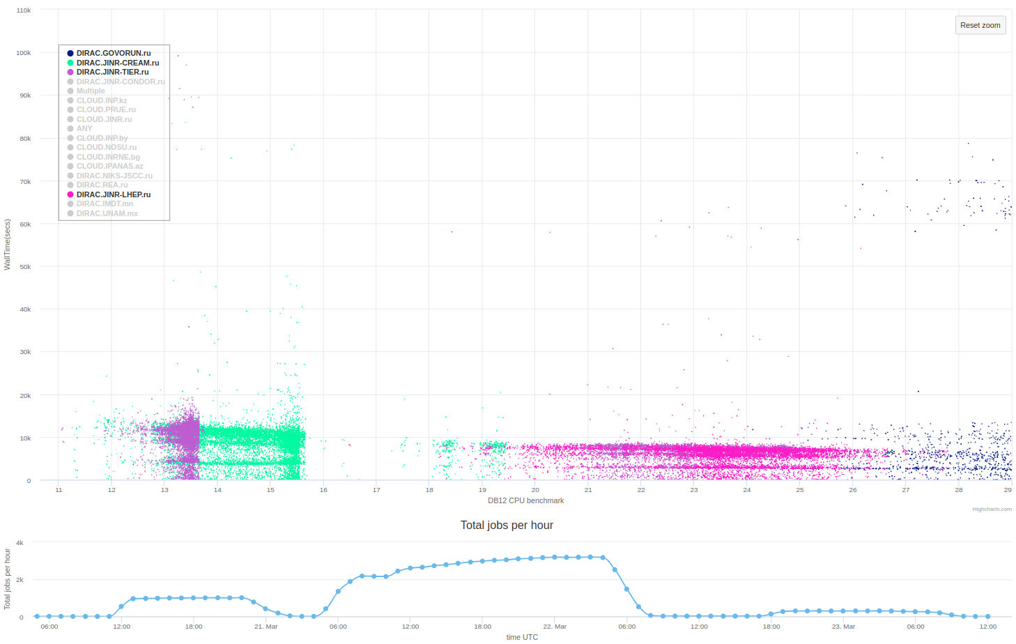
Step 5: Massive production Digi2Dst
Tier2
Govorun
Tier1 old cores
Tier1 new cores
NICA Cluster
~3100 Running jobs

Slide 14
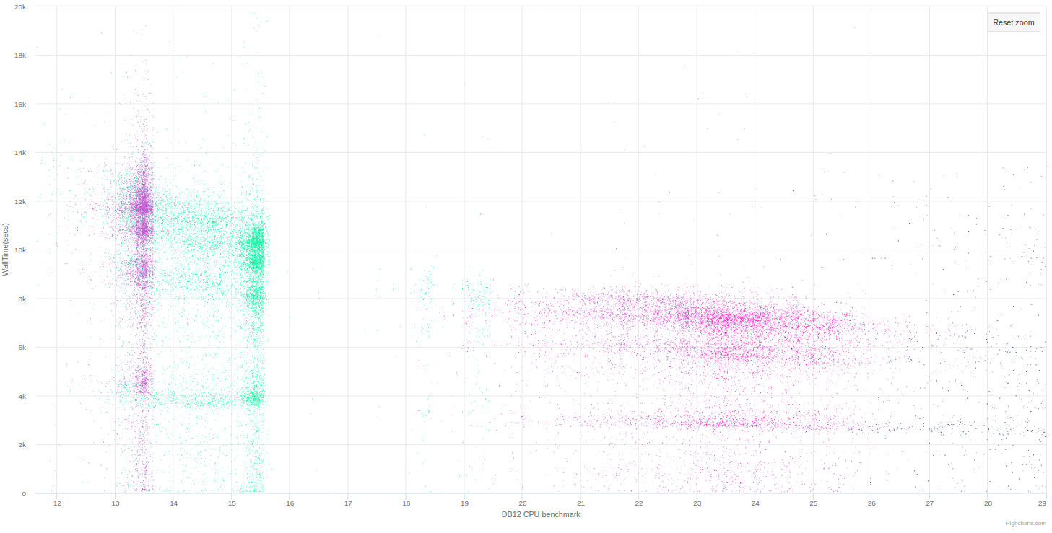
Step 5: Digi2Dst job’s segregation

Slide 15
Estimations
Max CPU cores utilized
Type | Tier1 | Tier2 | NICA cluster | Govorun | CPU core years required | Duration with all resources
Raw2Digi | 1500 | - | 100 | 100 | 3.5 years | 18 hours
Digi2Dst | 1500 | 1000 | 300 | 200 | 10 years | 30 hours
Disclaimer! All cores listed in this table may be used by any NICA experiment. That means that if another experiment use them at the same time the resources will be equaly divided between experiments.
Disclaimer! This numbers do not take into consideration “Cold start” problem. Real numbers may be larger by 3-6 hours
Disclaimer! Assuming no major changes in bmnroot software. But they are gonna be there next time

Slide 16
First time JINR computing infrastructure united by DIRAC was used for raw data reconstruction not in test mode but in production.
Results
Full BM@N run8 reconstruction takes considerable amount of resources. And, what’s more important, specific computing resources that can sustain high load on disks. Up to now ~ 20 CPU core years has been consumed.
Now, we have new experience. With all NICA computing resources available through DIRAC, presuming they are free from other’s experiments work, it would take around 1 week to repeat all reconstruction.

Slide 17
DIRAC: Igor Pelevanyk
BM@N: Konstantin Gertsenberger
Responsible for resources:
Govorun: Dmitry Podgainy, Dmitry Belyakov, Aleksandr Kokorev, Maxim Zuev,
NICA cluster: Ivan Slepov, Boris Schinov
Tier-1,Tier-2, EOS: Valery Mitsyn
List of participants

Slide 19
Individual CPU core performance study
Centralized job management gives possibility for centralized and unified performance study of different computing resources.
Before running user jobs DIRAC Pilots execute benchmark for CPU core they are running on.
Benchmark is DiracBenchmark2012 or DB12. It evaluate just CPU core performance. Disk I/O, RAM speed, Network, CPU caches and other highly important aspects of performance are neglected by DB12.

Slide 20
DB12 benchmark study
Piece of road from point A to B
A Monte-Carlo task
Speed of the car
Performance of the computer
Time to complete
Time to complete
$$Time= \frac{Amount of work}{Speed of computer}$$
DB12 gives results like: 10(old slow core), 17 (standard server core), 27 (high performance core)
What if we build a plot, where X is DB12 result, Y is time in seconds. Then, every point on the plot represent one job.
It would be mostly useless if all jobs were unique and different. But, in the real life there are usually many similar jobs.

Slide 21
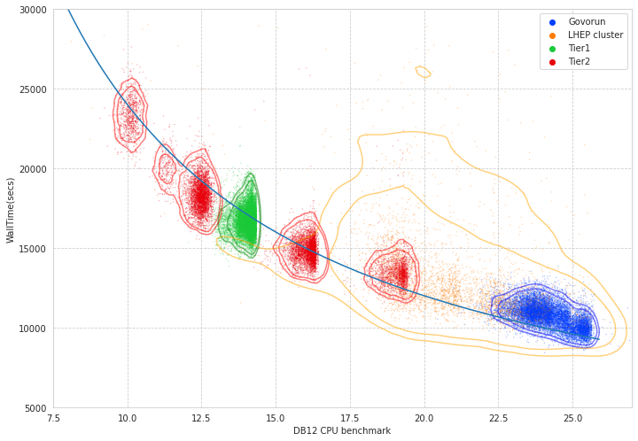
Performance analysis

Slide 22
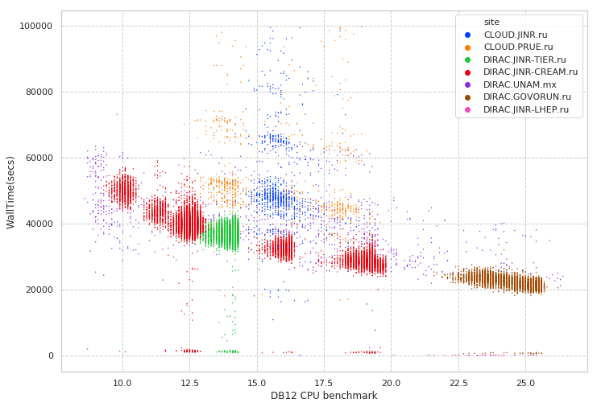
Performance analysis
Folding@Home
MPD MC
Immediate errors or short jobs
Errors during execution

Slide 23
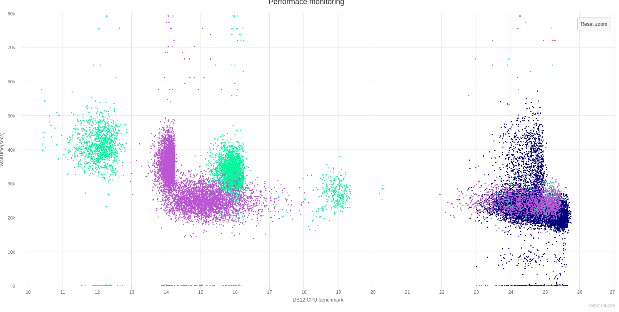
Discoveries
Wrong AMD processors estimation
Occasional speed loss on high ram Govorun nodes
Walltime
DB12 benchmark

Slide 24
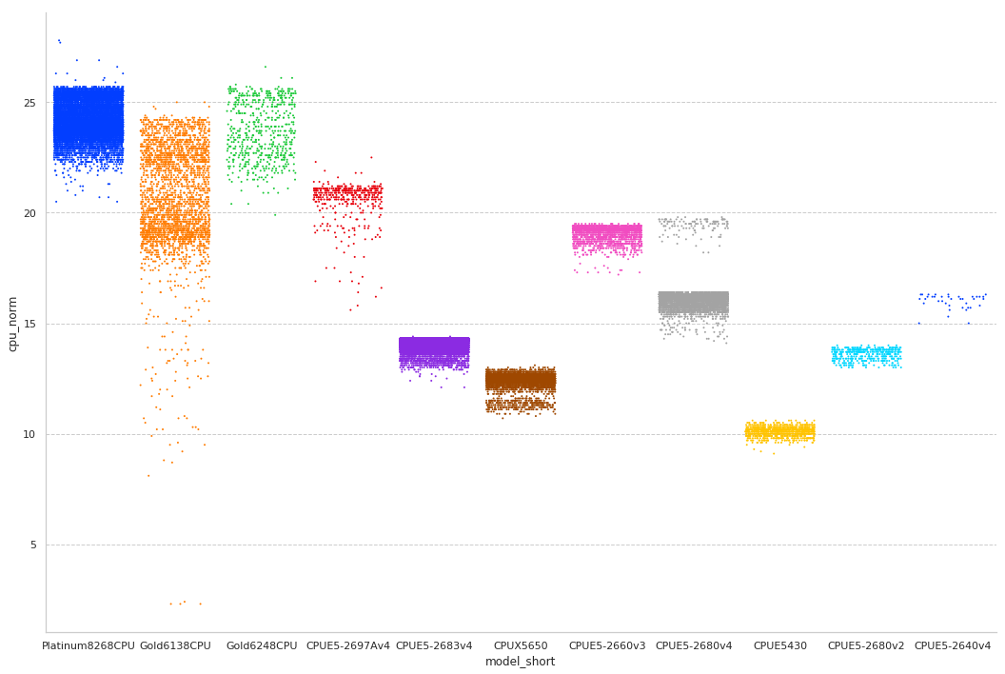
CPU core performance

Slide 25
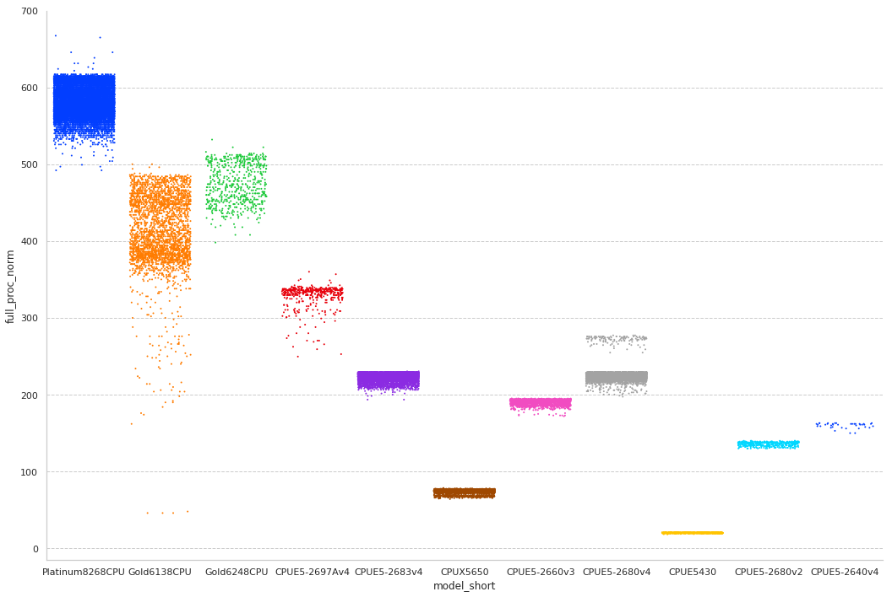
Total CPU performance

Slide 26
User job monitoring
$ root macro.c(input)
$ job_monitoring root macro.c(input)
User job
(root)
job_monitoring
User job
(root)
Monitoring DB
(InfluxDB)

Slide 27
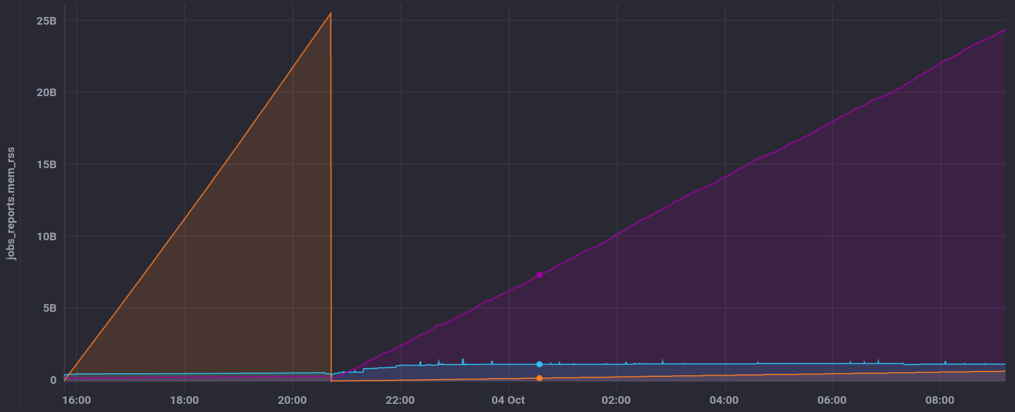
User job monitoring
GenToDst job on Govorun
Disk write
Disk read
RAM usage

Slide 28
Detailed articles
1. Gergel, V., V. Korenkov, I. Pelevanyuk, M. Sapunov, A. Tsaregorodtsev, and P. Zrelov. 2017. Hybrid Distributed Computing Service Based on the DIRAC Interware.
2. Korenkov, V., Pelevanyuk, I. & Tsaregorodtsev, A. 2019, "Dirac system as a mediator between hybrid resources and data intensive domains", CEUR Workshop Proceedings, pp. 73.
3. Balashov, N.A., Kuchumov, R.I., Kutovskiy, N.A., Pelevanyuk, I.S., Petrunin, V.N. & Tsaregorodtsev, A.Y. 2019, "Cloud integration within the DIRAC Interware", CEUR Workshop Proceedings, pp. 256.
4. Korenkov, V., Pelevanyuk, I. & Tsaregorodtsev, A. 2020, Integration of the JINR hybrid computing resources with the DIRAC interware for data intensive applications.
5. Kutovskiy, N., Mitsyn, V., Moshkin, A., Pelevanyuk, I., Podgayny, D., Rogachevsky, O., Shchinov, B., Trofimov, V. & Tsaregorodtsev, A. 2021, "Integration of Distributed Heterogeneous Computing Resources for the MPD Experiment with DIRAC Interware", Physics of Particles and Nuclei, vol. 52, no. 4, pp. 835-841.
6. Pelevanyuk, I., "Performance evaluation of computing resources with DIRAC interware", AIP Conference Proceedings 2377, 040006 (2021)

